Slide 1
DECENTRALIZED AUTONOMOUS ORGANIZATION
Submitted in the partial fulfillment for the award of the degree of
BACHELOR OF ENGINEERING
IN
CSE with specialization in IOT
Submitted by:
Baby Monal (21BCS4526)
Sehajpreet Kaur (21BCS4518)
Under the Supervision of:
Ms. Priyanka Jammwal
Department of AIT-CSE
DISCOVER . LEARN . EMPOWER

Slide 2
Outline
Introduction to Project
Problem Formulation
Objectives of the work
Methodology used
Results and Outputs
Conclusion
Future Scope
References

Slide 3
Introduction to Project
The research paper highlights issues in modern organizations due to centralized decision-making and manual processes, proposing a solution through DAO (Decentralized Autonomous Organizations).
DAO advocates for decentralized decision-making, community ownership, and automation to address inconsistencies and trust concerns, prioritizing global implementation with a focus on security and compliance.
The proposed work explores traditional organizations' challenges in the digital age and emphasizes the transformative potential of DAOs and smart contracts in improving organizational dynamics by implementing a dapp.
The overarching goal is to enhance the global implementation of these technologies for more efficient and dynamic organizations.

Slide 4
Problem Formulation
In modern organizations, centralized decision-making and manual administrative processes lead to problems like inconsistencies, limited inclusiveness, and trust issues.
To address these challenges, the proposed solution involves promoting decentralized decision-making, community ownership, and automation while ensuring security and compliance.
The ultimate aim is to enhance and globally implement this evolving technology.

Slide 5
Objectives of the Work
This paper explores how traditional organizations face issues like centralization, opacity, and inefficiency in today's digital world.
It focuses on Decentralized Autonomous Organizations (DAOs) and the challenges of implementing them, with an emphasis on smart contracts.
The paper aims to demonstrate how DAOs, enabled by smart contracts, can transform and improve organizational dynamics.

Slide 6

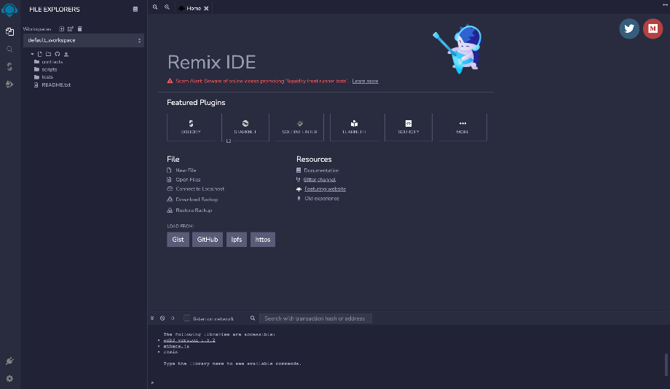
Methodology used
Gitpod: Cloud-based IDE enabling web-based coding, testing, and project development.
Remix IDE: Comprehensive tool suite for Ethereum-compatible smart contract development and analysis.

Slide 7
MetaMask Wallet: Mobile/web app for remote Ethereum wallet management and interaction with decentralized apps.
Hardhat Configuration: Framework for building digital currency applications with customization, compilation, debugging, and deployment capabilities.
Localhost: Virtual server address for testing and developing applications by uploading source code and exporting data.

Slide 8
Results and Outputs
1.. Project setup:
•Create a new project directory for your dApp.
• Use npm init to start a new Node.js project. By doing this, you can set up the package.json file to manage the dependencies and scripts for your project.
2. Implementing Intelligent Contracts:
•Use Solidity to write the code for your smart contract. The contract should include functions to handle deposits and withdrawals.
•Use the Hardhat framework for compiling, deploying, and testing your smart contracts. You'll need to install Hardhat and set up a Hardhat project.

Slide 9
UI development:
Create HTML files for your dApp UI. This HTML file will serve as the user interface of your application.
Add buttons for the "Deposit" and "Withdraw" actions in your HTML file. These buttons will trigger interaction with your smart contract.
Configure your front-end code's Web3.js instance. A JavaScript library called Web3.js is used to communicate with the Ethereum blockchain.
Use a MetaMask-injected Web3 provider to enable communication with the Ethereum network. This allows users to sign transactions and interact with your dApp.

Slide 10
MetaMask integration:
Install the MetaMask browser extension in your browser.
Create a MetaMask wallet or connect an existing wallet to a test network you are using (e.g. Localhost for development or a test network like Ropsten or Rinkeby).
Import Ether testnet to your MetaMask wallet with just one tap to use it for test transactions.
5. Hardhat network configuration:
Install Hardhat globally using npm install -g hardhat.
Create a Hardhat configuration file (hardhat.config.js) to determine your network settings. You will specify the provider URL for the test network (e.g.Alchemy, Infura) and configure the accounts for deployment.

Slide 11
Deploy smart contract:
Deploy your smart contract to the testnet using the Hardhat deployment script. You will use Hardhat's deploy function and specify the network to which you want to deploy the contract.
After deployment, get the contract address. This address is important for your user interface to interact with the smart contract.
7. UI Interaction:
In your UI code, use the Web3.js library to connect to your deployed smart contract. You will need to provide the ABI (Application Binary Interface) and contract address.
Implement JavaScript functions in your interface to handle the "Deposit" and "Withdrawal" actions. These functions will call the corresponding smart contract methods and interact with MetaMask to sign transactions.

Slide 12
User Testing:
Test your dApp on the testnet by interacting with the "Deposit" and "Withdrawal" buttons using MetaMask.
Ensure transactions are signed and executed correctly on the blockchain.
You can open Etherscan to view your transaction history and confirm that your app is working as expected.
This step-by-step process covers the development and testing of a basic dApp for handling deposits and withdrawals, including integrating MetaMask, deploying smart contracts, and building the front end. It's a fundamental example of how to create a blockchain-based application.

Slide 13
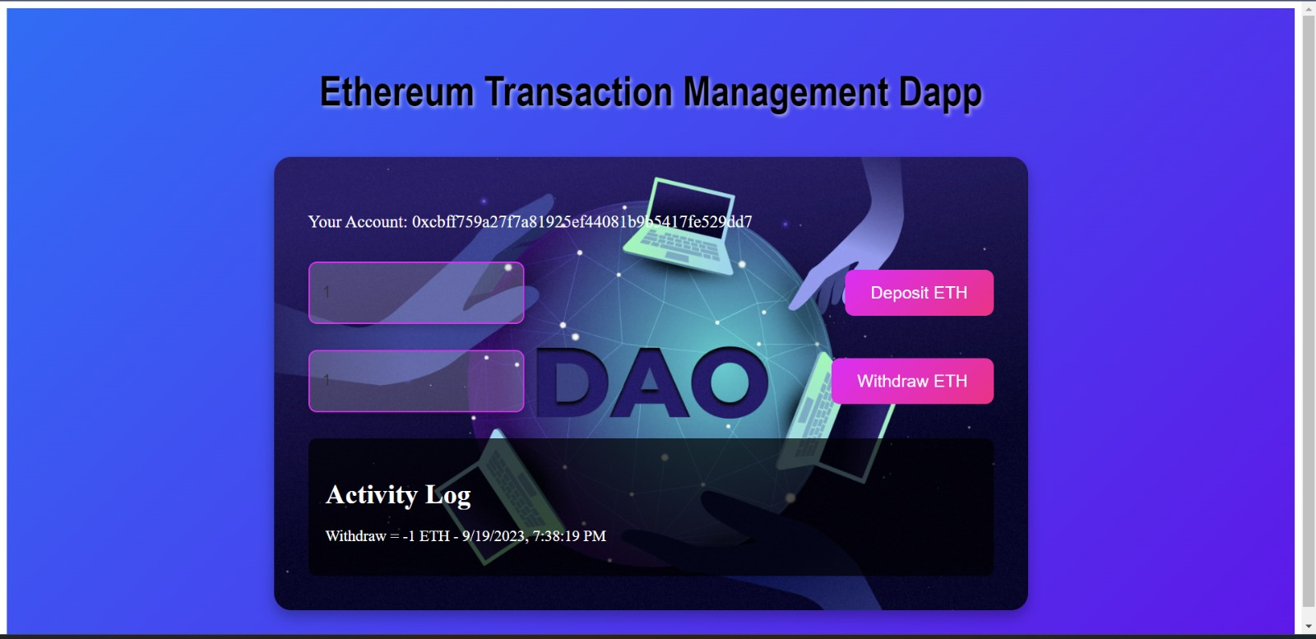
Outputs

Slide 14
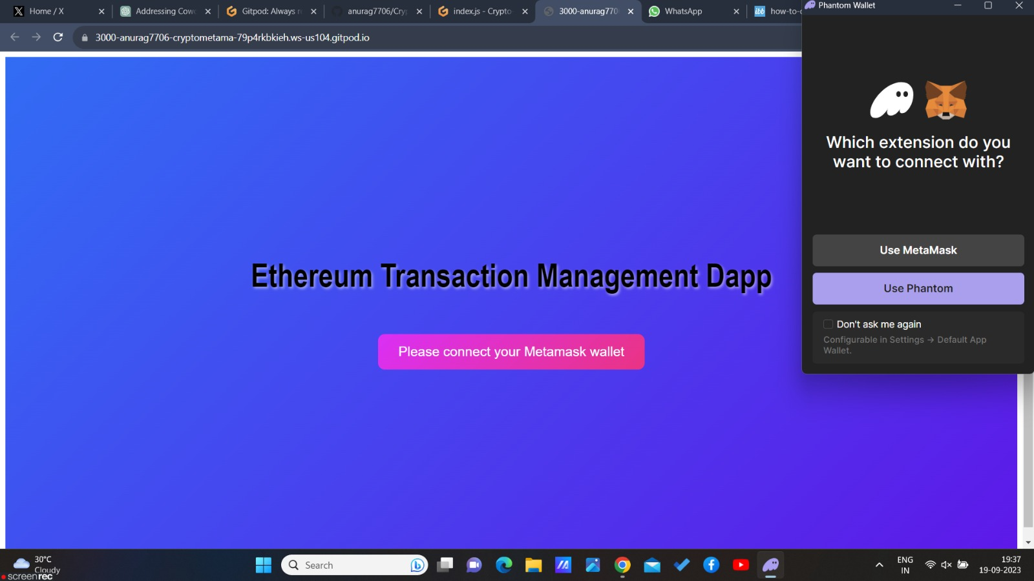

Slide 15
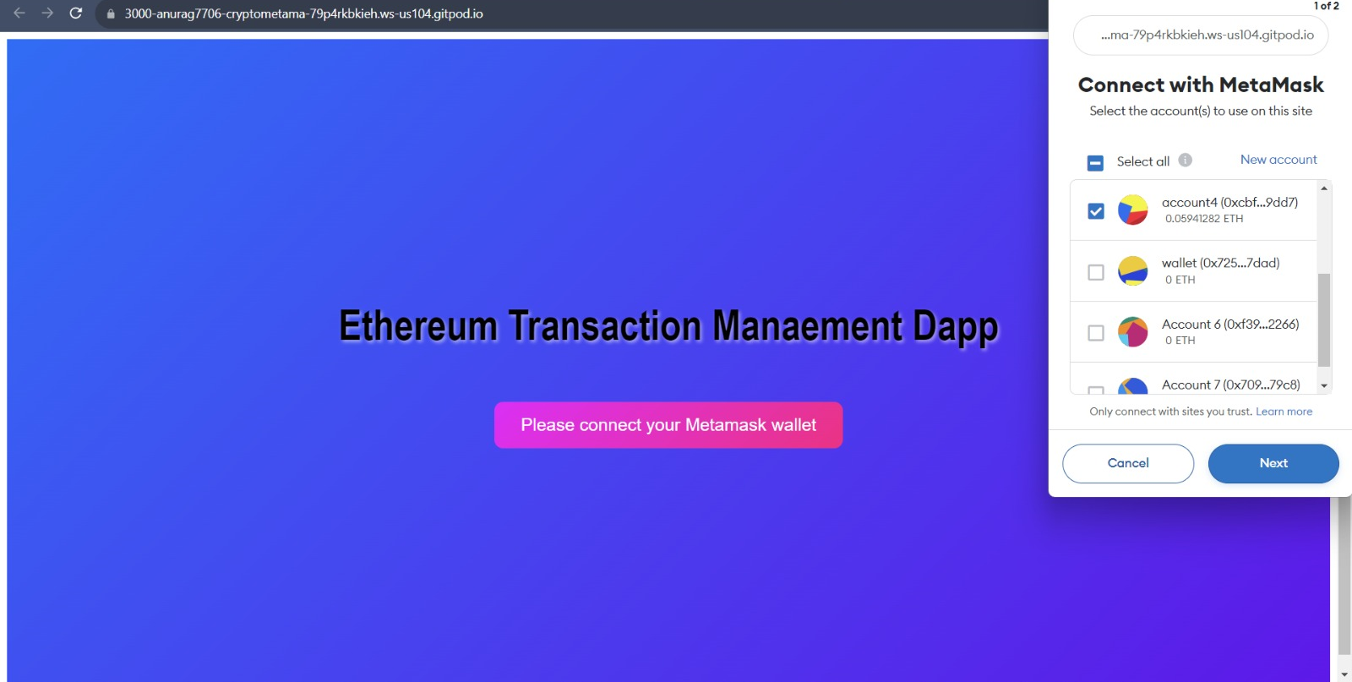

Slide 16
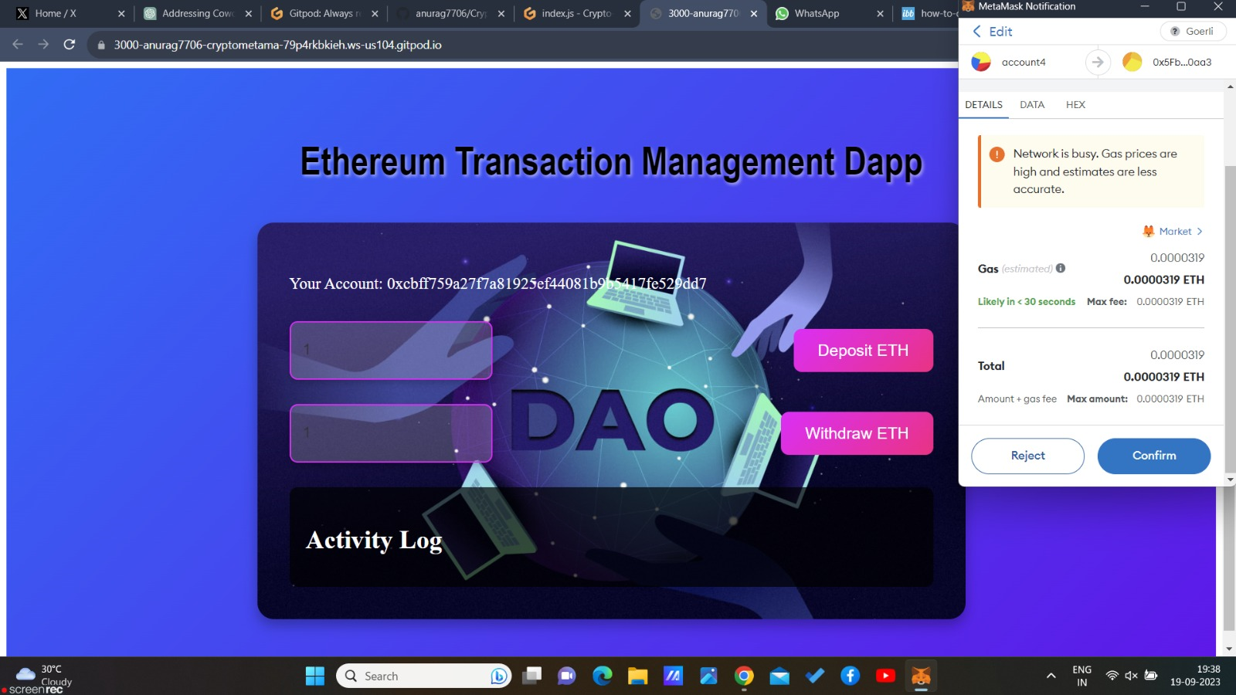

Slide 17
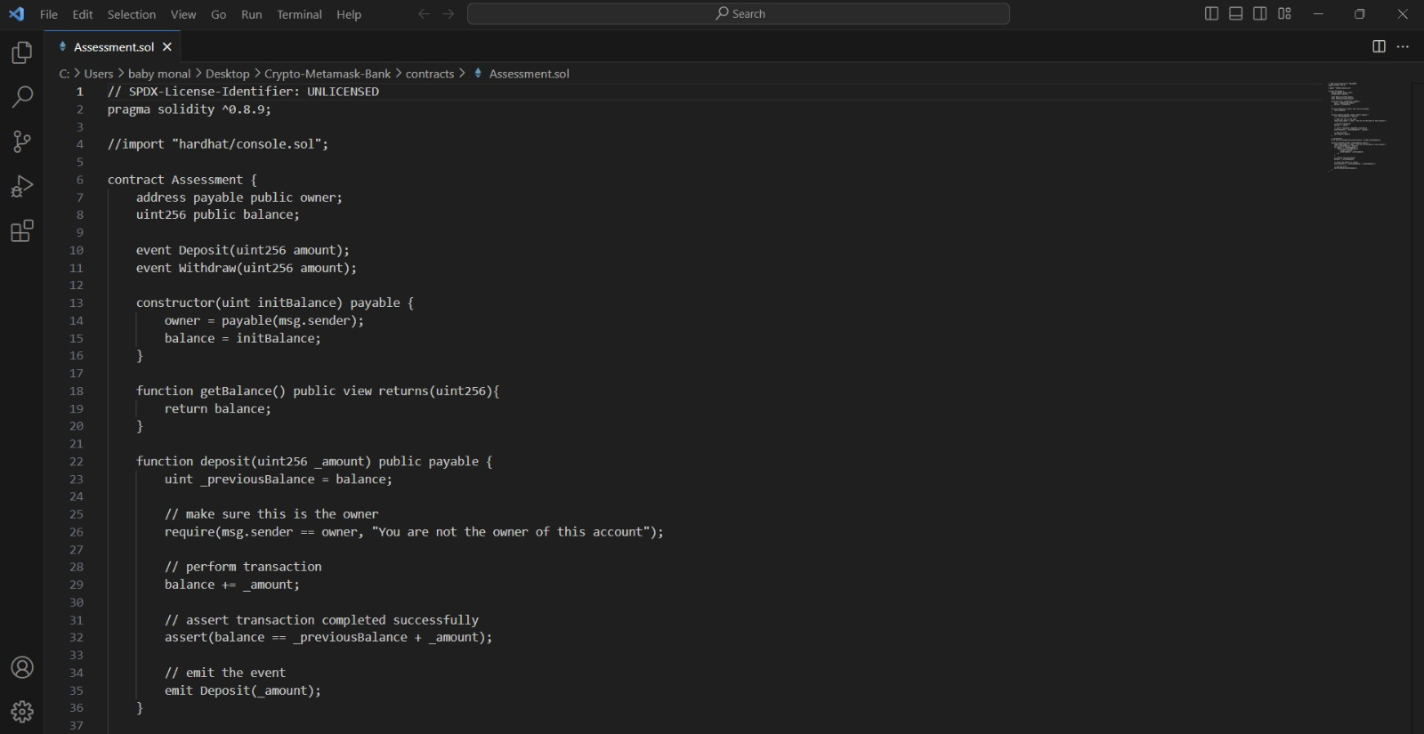

Slide 18
Conclusion
In conclusion, the exploration of Decentralized Autonomous Organizations (DAOs) highlights their transformative potential, offering decentralized governance, transparency, efficiency, and global inclusivity.
Despite challenges, DAOs are poised to revolutionize organizational structures, fostering transparency, inclusivity, and innovation in the evolving landscape.
However, challenges like security risks, accountability issues, and complex design must be addressed.
The future of DAOs looks promising with widespread adoption and integration into various industries, signaling a shift toward decentralized decision-making. Despite challenges, DAOs have the potential to reshape traditional organizations for greater transparency, inclusivity, and innovation.

Slide 19
Future Scope
Widespread Adoption: Anticipate increased DAO adoption in diverse industries, including arts, entertainment, and healthcare.
Web3 Integration: DAOs will lead the Web3 movement, collaborating with dApps, DeFi, and blockchain platforms.
Gaming DAOs: Gain traction in the gaming industry, impacting game development and virtual economies

Slide 20
References
[1] Shuai Wang, Wenwen Ding, Juanjuan Li, Yong Yuan, Liwei Ouyang, and Fei-Yue Wang, “Decentralized Autonomous Organizations: Concept, Model, and Applications”, IEEE TRANSACTIONS ON COMPUTATIONAL SOCIAL SYSTEMS, October 2019, pp. 870-878, vol: 6, issue: 5, doi: 10.1109/TCSS.2019.2938190.
[2] Youssef El Faqir, Javier Arroyo, and Samer Hassan, “An overview of decentralized autonomous organizations on the blockchain”, OpenSym 2020: 16th International Symposium on Open Collaboration, August 2020, DOI:10.1145/3412569.3412579.
[3] Lu Liu, Sicong Zhou, Huawei Huang, Zibin Zheng, “From Technology to Society: An Overview of Blockchain-based DAO”, IEEE Open Journal of the Computer Society, 2021, vol. 2, pp. 204-215, 2021, doi: 10.1109/OJCS.2021.3072661.
[4] Youssef Faqir-Rhazoui, Javier Arroyo and Samer Hassan, “A comparative analysis of the platforms for decentralized autonomous organizations in the Ethereum blockchain”, Journal of Internet Services and Applications, 01 October 2021, doi: 10.1186/s13174-021-00139-6, pp 2-20.

Slide 21
[5] Alexandra Sims, “Blockchain and Decentralised Autonomous Organisations (DAOs): the evolution of companies?”, Social Science Research Network, November 1, 2019, pp 423-458.
[6] Wulf A. Kaal, “A Decentralized Autonomous Organization (DAO) of DAOs”, Social Science Research Network, March 6, 2021.
[7] Romex K Jha,” Challenges of Effective Decision Making in Decentralized Autonomous Organizations (DAOs)”, World Journal of Research and Review, ISSN: 2455-3956, Volume-17, Issue-1, July 2023 Pages 18-25.
[8] Anjani Raj Yadlapalli, Ninad Mohite, Vijayant Pawar, Shelly Sachdeva, “Artificially Intelligent Decentralized Autonomous Organization”, 2019 4th International Conference on Information Systems and Computer Networks (ISCON), pp. 667-671, doi: 10.1109/ISCON47742.2019.9036152

